Slide 1
SCIENCE
INTRODUCTION

Slide 2
Definition
Derived from Latin word ‘Scientia’ means Knowledge
In simple words Science is the systemized knowledge derived from observation, study, and experimentation in order to understand natural phenomenon and other objects.
‘systematic study of demonstrable truths and phenomena under observation. Characterized by systematic application of scientific method’.

Slide 3
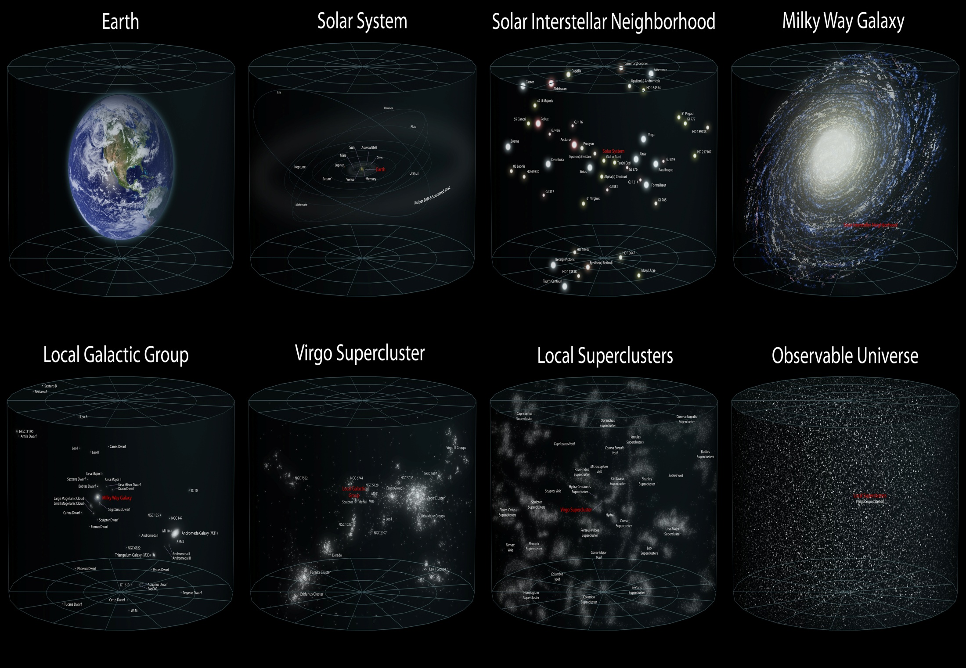

Slide 4
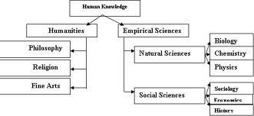

Slide 5
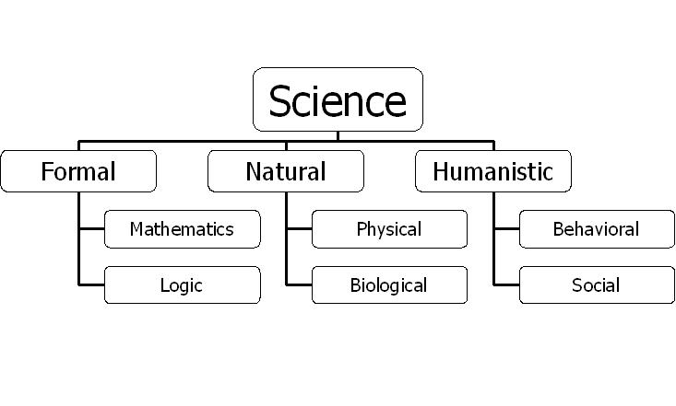

Slide 6
examples
Physical:
Physics
Chemistry
Physical Geography
Geology
cosmology
Biological:
Botany
Zoology
Physiology
anatomy
Social:
Sociology
psychology

Slide 7
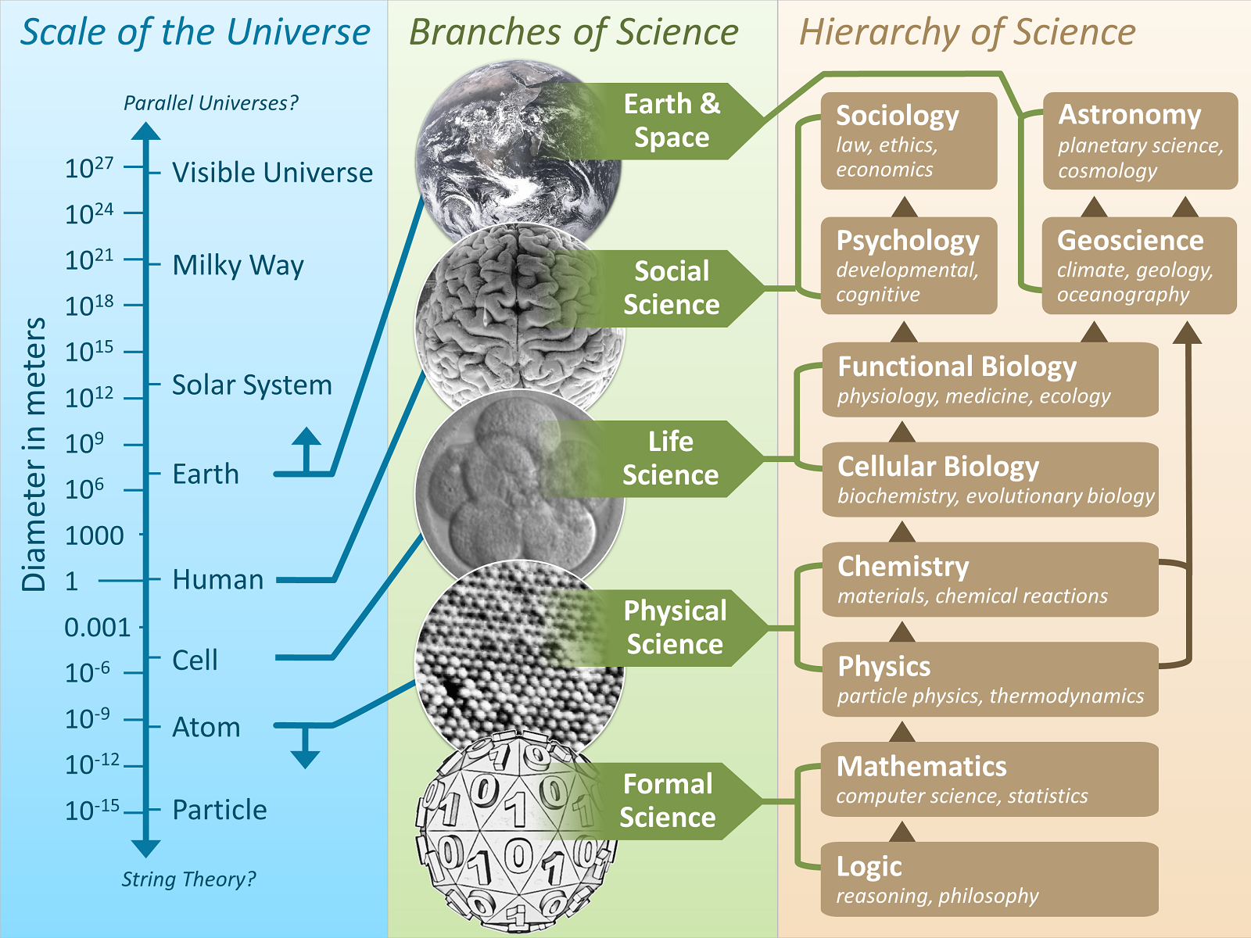

Slide 8
Scientific Methodology
Various methods adopted in science, which distinguish science from other branches of arts and knowledge.
Elements / components of Scientific method:
Problem / question
Background research
hypothesis
Experimentation
Analysis of the data
Drawing conclusions

Slide 9
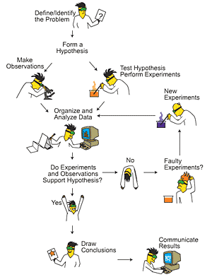

Slide 10
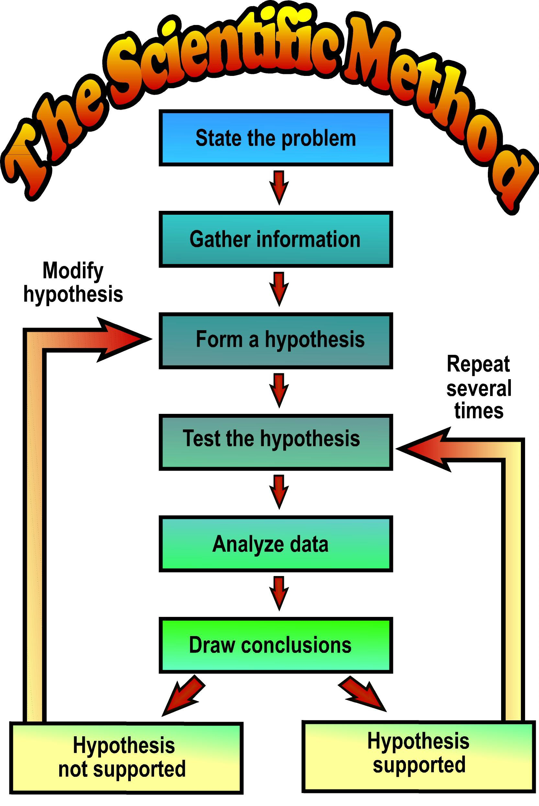

Slide 11
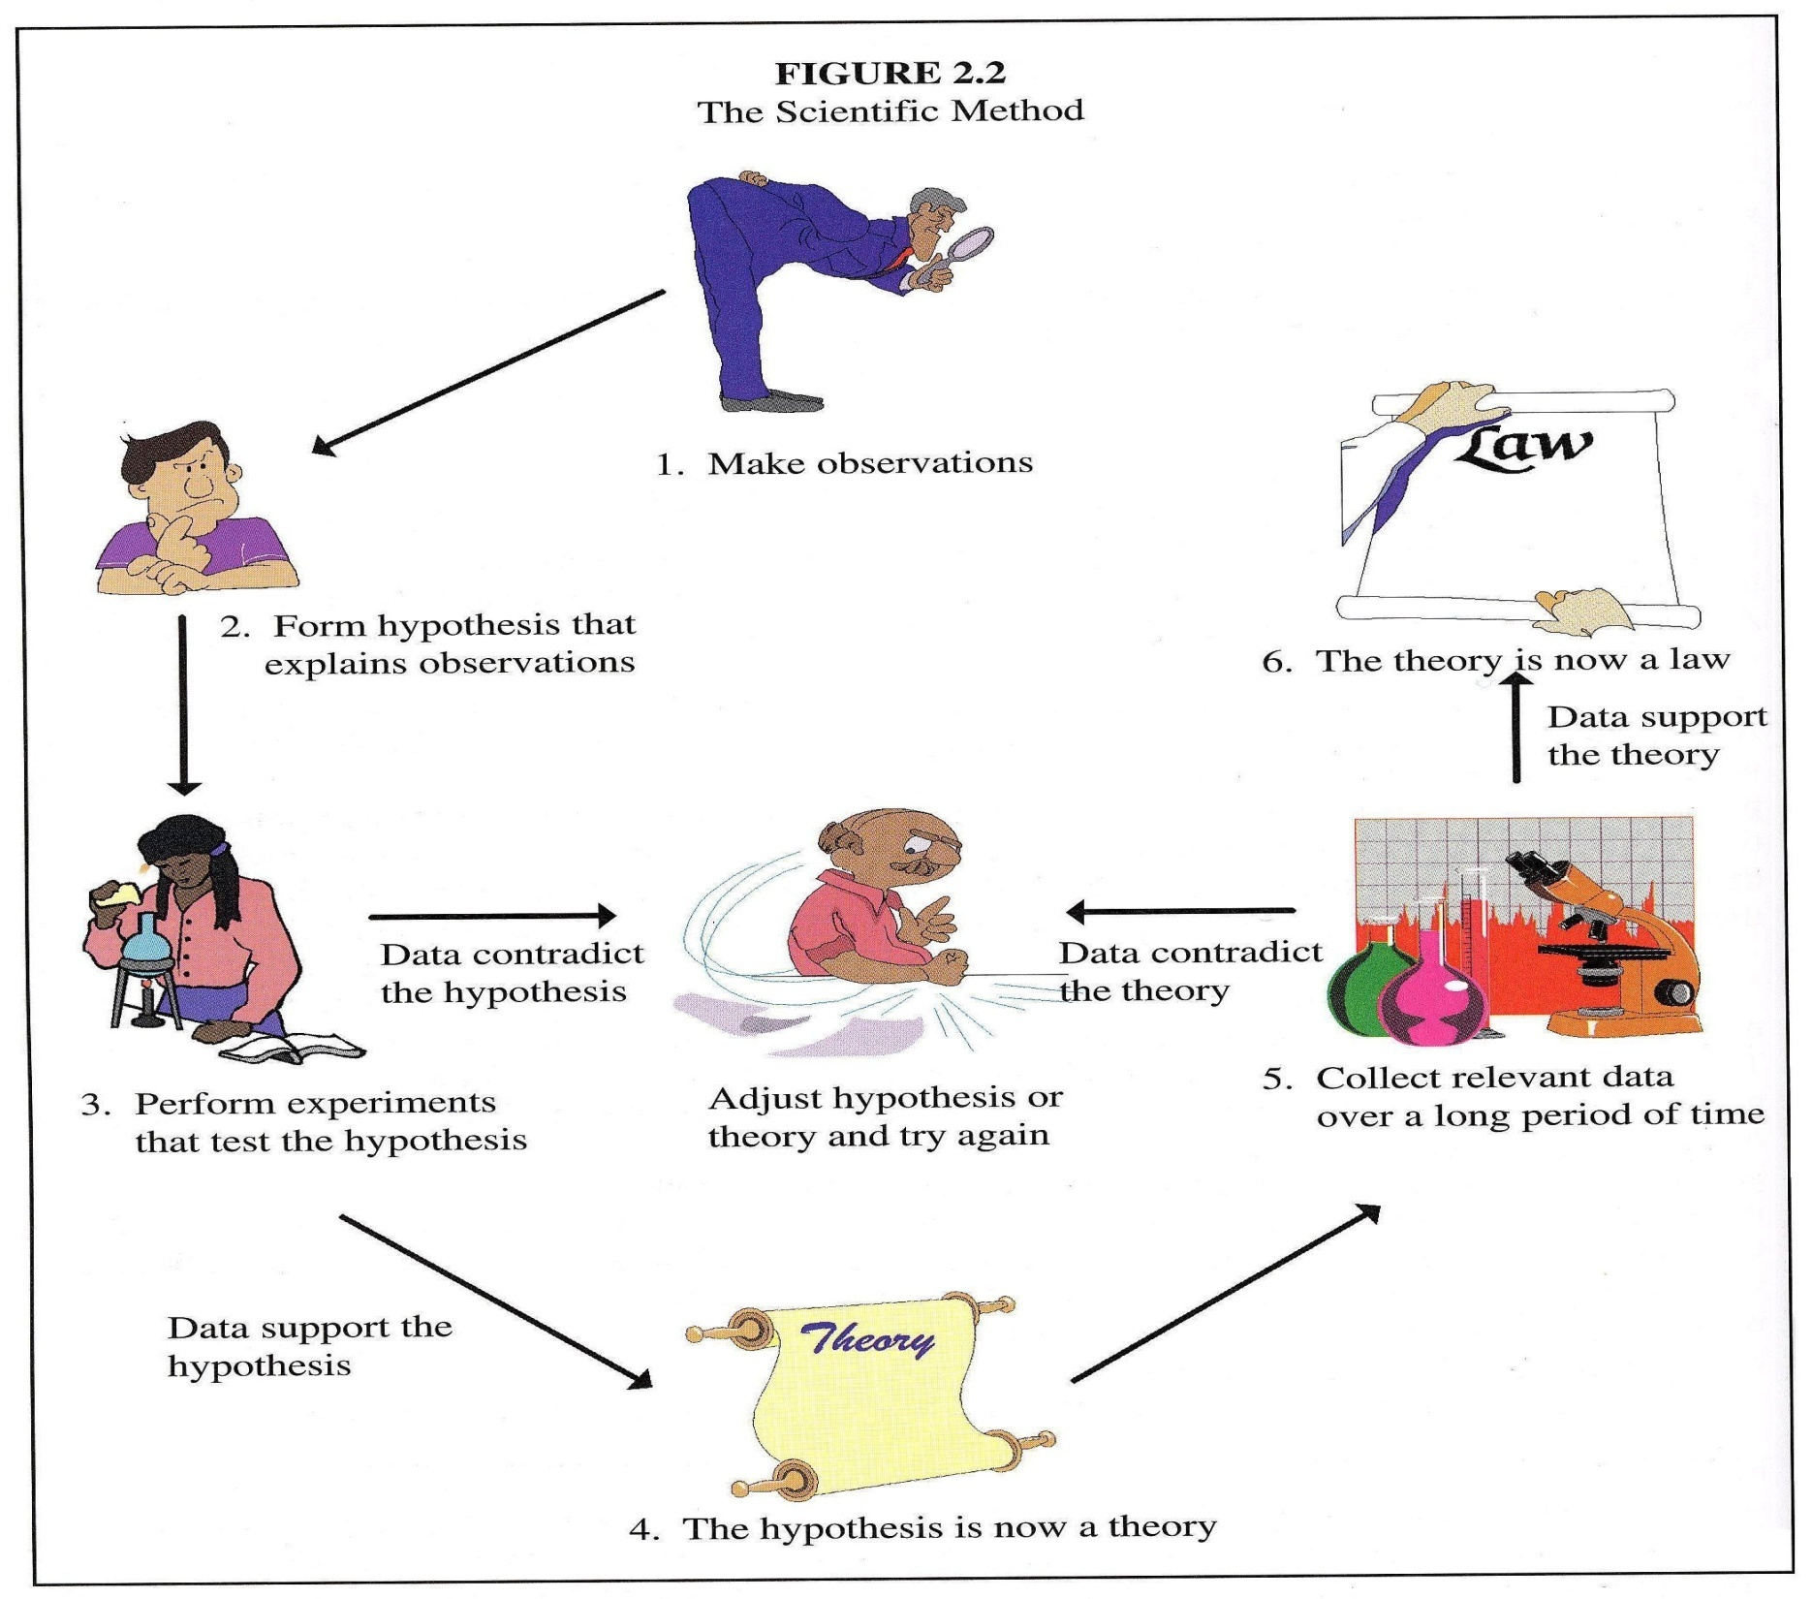

Slide 12
Role of Science in Human Life
Science has brought advancement and revolution in walk of life:
Communication:
Satellite, telephone, internet, radio, television
Transport:
Buses, cars, electric trains, supersonic aero planes
Economy
Agriculture: pesticides, fertilizers
Industry: electrical and mechanical machines
Education:
Calculators, computers, internet, more source of knowledge, research, information sharing
Medical:
Disease prevention; vaccines
Diagnostic tools; X-Rays, CT , MRI, ECG
Treatment modalities; anti-biotics, radiotherapy, chemotherapy,

Slide 13
Hazards of science
Environmental pollution
Green house effect
Global warming
Ozone depletion
Weapons of mass destruction
Fast, competitive life; tension, depression
Materialism; moral and ethical decline

